Slide 1
ANALYSING THE AMAZON SALES TO IMPROVE SUPPLY CHAIN OPTIMISATION,ASSOCIATION RULE,MANAGING INVENTORY USING PYTHON,SQL(ETL),JUPYTER NOTEBOOK. *by Shubham Ingle
AMAZONE SALES PROJECT
FINALE PROJECT

Slide 2
PROJECT OUTLINE
Problem Statement.
Creating ETL(extract transform load of data) Pipeline for data.
Data Cleaning.
Feature Engineering.
Data Visualisation.
Conclusion.

Slide 3
PROBLEM STATEMENT
In Which Day We Need Plane A Big Billion Day Sale.
Find In Which Month Maximum Sales And Ordered Quantity .
Find In Which Day Maximum Sales And Ordered Quantity .
Find In Which Hour Maximum Sales And Ordered Quantity .
We Need To Recommend A Products To Customer.
In Which City Max Sales And Ordered Quantity.
Top5 Products Sold In Which Particular City.
Top 20 Product Bought By Combination.

Slide 4
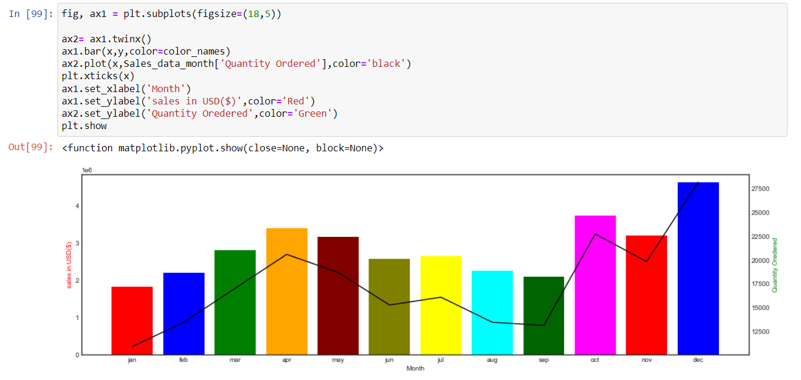
From this graph we can easily see in the month of December we get max sale and quantity ordered.

Slide 5
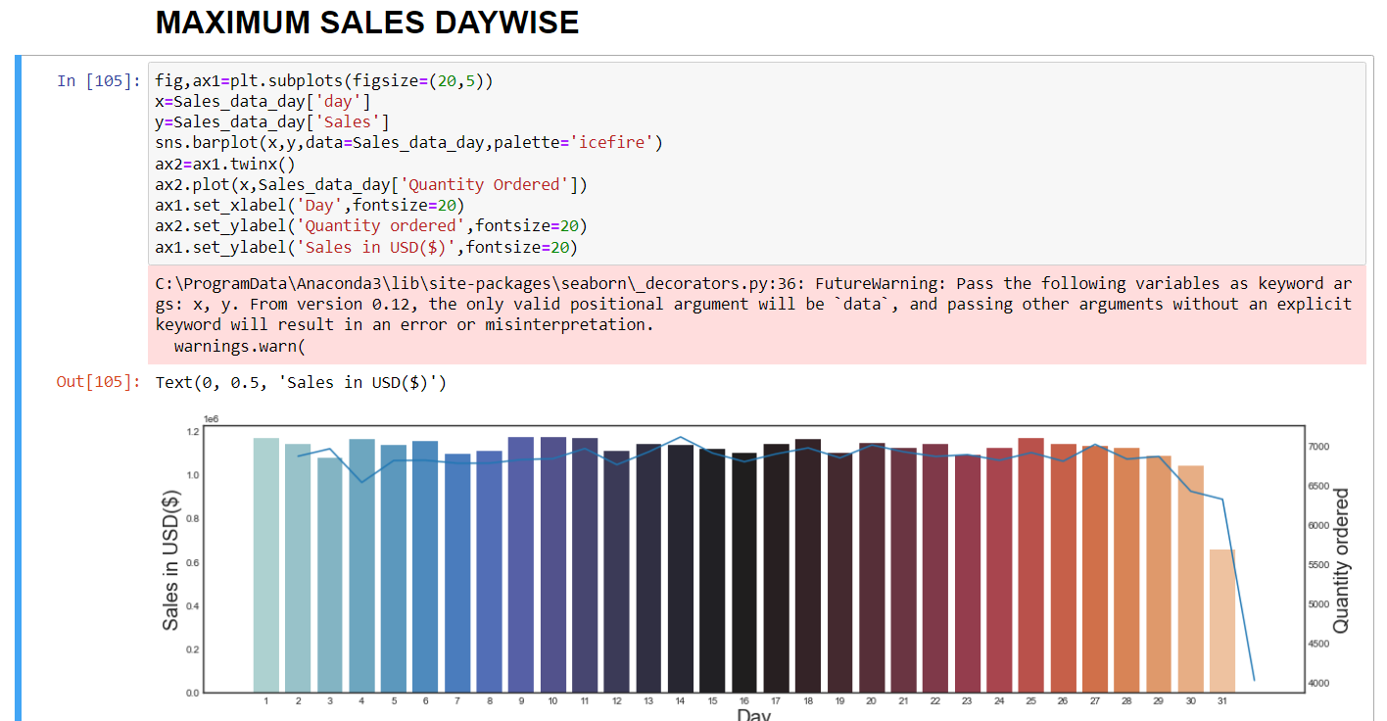
This Is The Day Wise Sale In The Month Of December So We Plane Our Big Billion Day On The Day Of 8,9,10 So We Can Boost Our Sales.

Slide 6
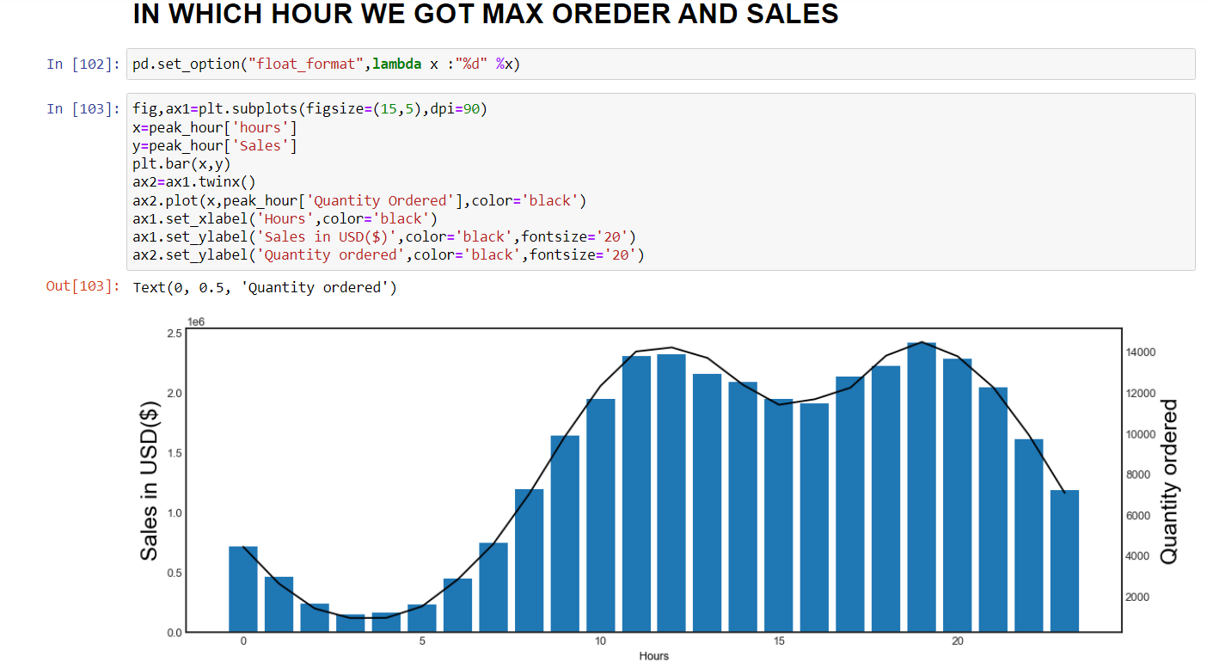
In Hourly Sales We Get Max Ordered On The 10AM So Its Better To Plan Big Billion Sales In The December Month On The Day Of 8,9,10 In The 10AM So We Get Max Sale.

Slide 7
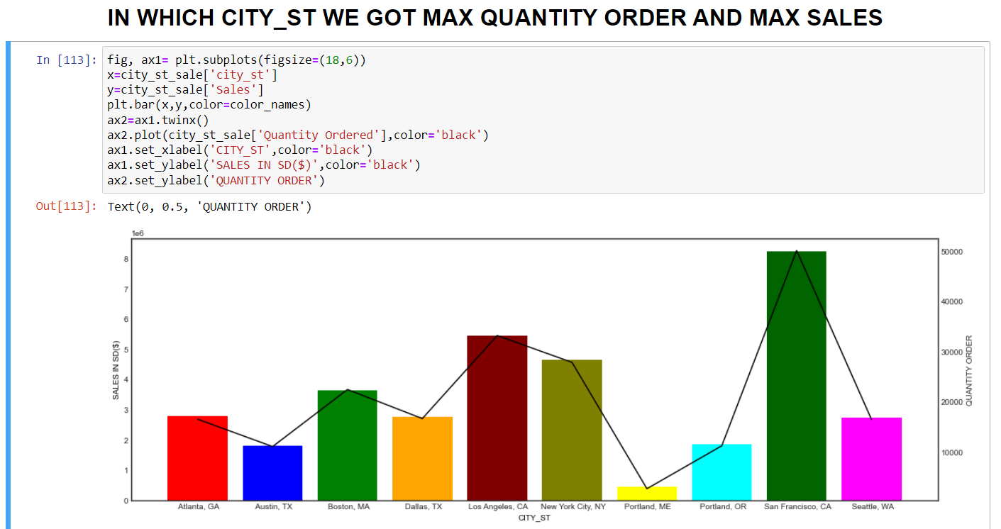
In The City Of San Francisco We Get Max Sale And Ordered Quantity So We Improve Supply Chain Optimisation By Targeting The City Of San Francisco By Opening New Warehouses.

Slide 8
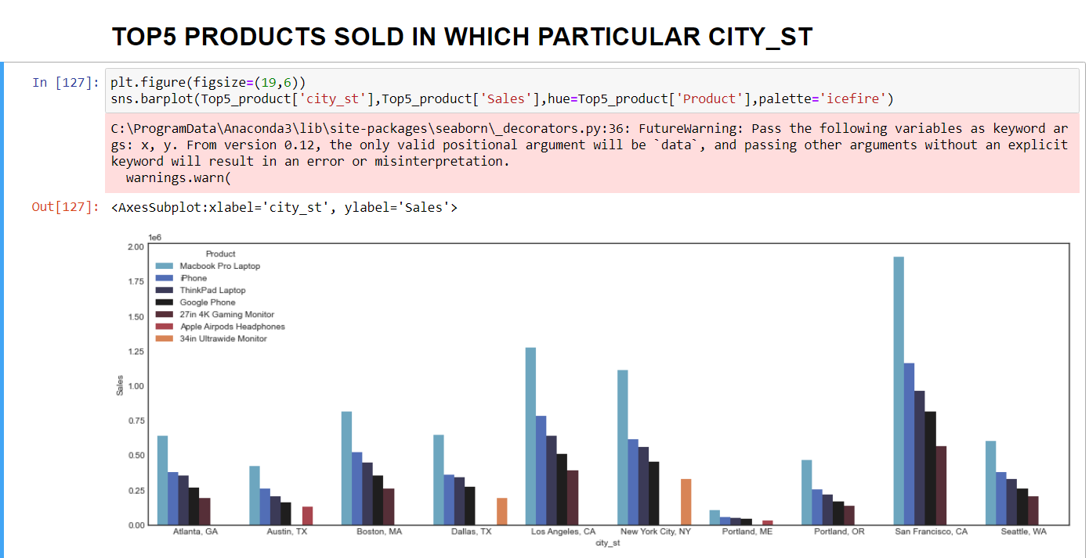
This Are The Top 5 Product As Per The City. In The City Of San Francisco. There Are The Five Product Which Sold Most In That Particular City. By This Insight We Solved The Problem Of Managing Inventory For Supply Chain Optimisation For Specific City. Specifically We Can Target This 10 City For Overall Supply Chain Optimisation.

Slide 9
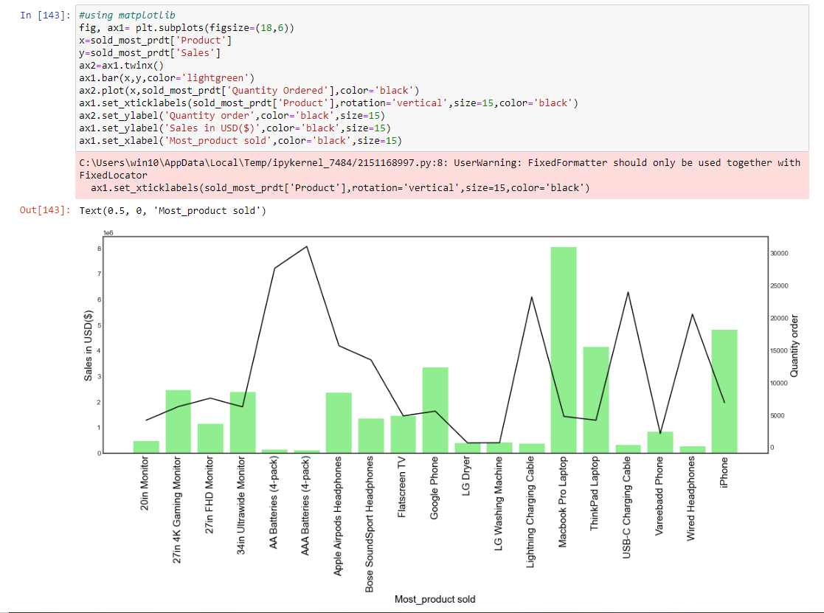
This are the 20 products which is bought in the combination of two by customer. This insight we got from the ordered pattern of customer. So now we can recommend this products in our upcoming big billion day sales to the various customer.in this way we increase our sales as well as ordered quantity.

Slide 10
CONCLUSION
In this whole project we focus more on which day is more suitable for planning a big billion day.
By data manipulation we able to find San Francisco has maximum sales and ordered quantity. In that we find top 5 most sold products by using this insight we solved the problem of supply chain optimisation.
In data visualisation we plot various graphs of monthly,daywise, hourly sales and quantity ordered we get best insight for the big billion day sales in the month of December on the day of 8,9,10 on the 10am we can plane our big billion day sales for customer.
As you all know in December month there is a festival so people are buying more for festival so for that there should not be delay in any product ordered by customer so supply chain optimisation is the most important key aspect for launching the big billion day sale.
By observing the previous ordered pattern of customer we find the most buying in combination product in that way we find 20 products that are need to recommend for customer in the upcoming big billion day sale.
This are the most important key aspect of launching a big billion day sale.

